Slide 1
CS3210 Tutorial 3
Memory Consistency and CUDA Programming
starting at :05 as usual, read the questions first
Notes:
Connect to xlog, cd lab3/
Connect to xlog, cd tut3/
CUDA occupancy calculator website

Slide 2
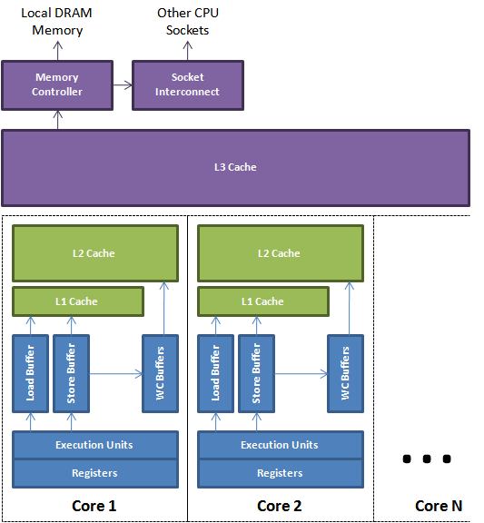
Today’s Big Concept: Coherence & Consistency
We take the performance of multi-core memory operations for granted!
Complex behavior: 2 issues
Coherence: how cores agree on what is at a single memory location
Consistency: how cores agree on the order of memory operations to different memory locations

Slide 3
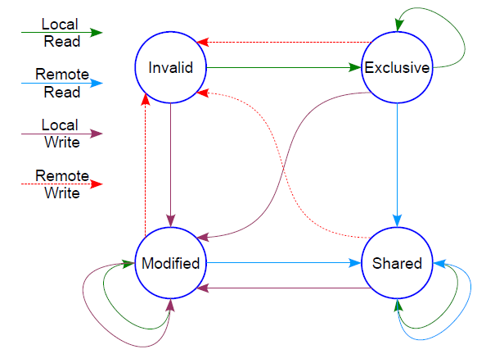
Coherence vs Consistency
Coherence
Core 1
Core 2
Core 3
X = 3
read X → r1
X = r + 1
read X
t
Usually: hardware has a cache coherence protocol.
Guarantees:
Write Propagation: changes in one cache are propagated to the rest, eventually
Tx Serialization: everyone sees changes in the same order
How does hardware make sure Core 3 reads x = 4?
We always assume that coherence is preserved! Insanity, otherwise.

Slide 4
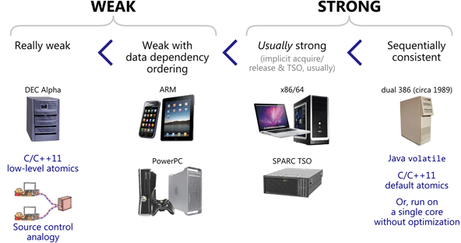
Coherence vs Consistency
Consistency
Core 1
Core 2
X = 3
print X
Y = 5
print Y
t
What guarantees does hardware give us about the result of these assembly instructions?
Each ISA (architecture) specifies exactly what we can expect!

Slide 5
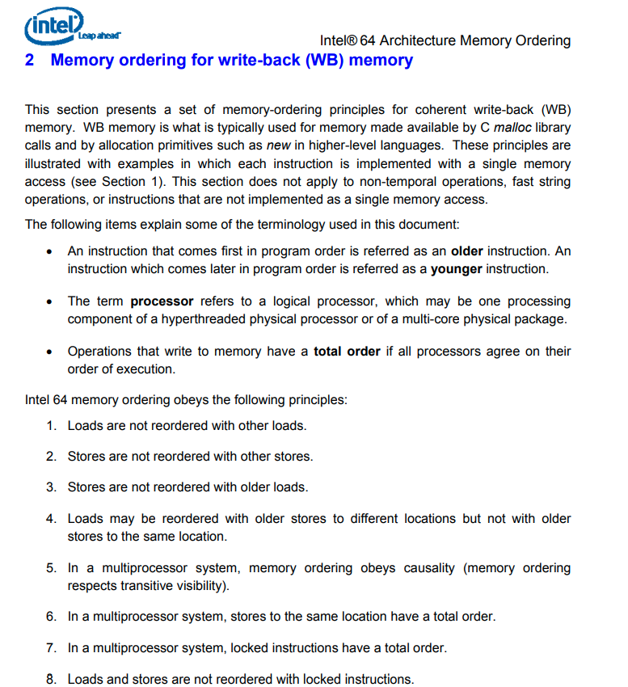
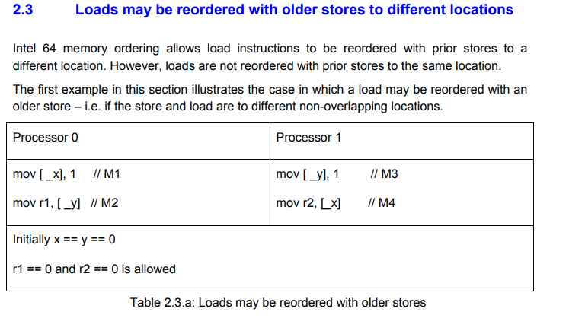
ISA specification of memory order
Note for (e.g.) CS3211: we are talking about hardware level ordering in CS3210!
i.e., what happens to assembly instructions, not high level languages like C++ with complex compilers
Notes:
https://www.cs.cmu.edu/~410-f10/doc/Intel_Reordering_318147.pdf

Slide 6
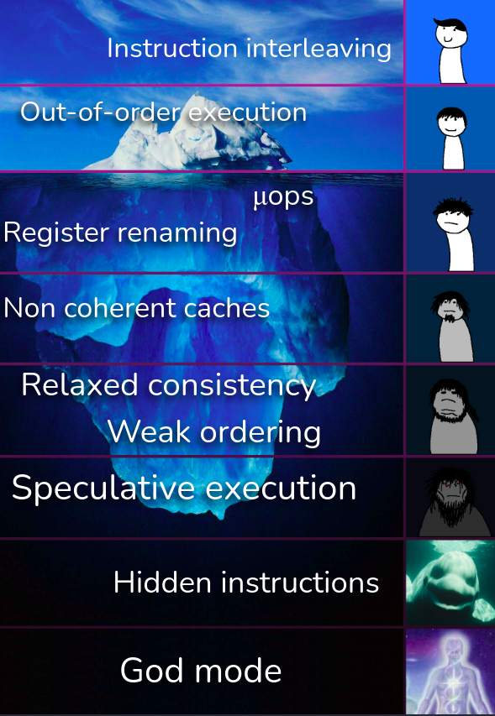
The Processor Black Magic Iceberg

Slide 7
Why does the hardware do these memory tricks?
Hardware-level stuff takes shortcuts to go fast while staying correct.
The best developers understand & exploit this to keep programs fast.

Slide 8
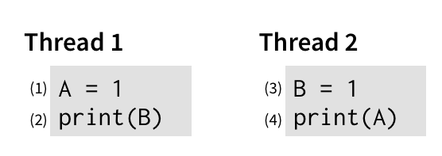
Why Relax our Memory Consistency?
Motivation: is sequential consistency the most sensible memory model?
Write: 2x slower than read
Write:
2x slower than read
Single Core’s view: why should “unrelated” writes prevent reads?
Ref: https://www.cs.utexas.edu/~bornholt/post/memory-models.html

Slide 9
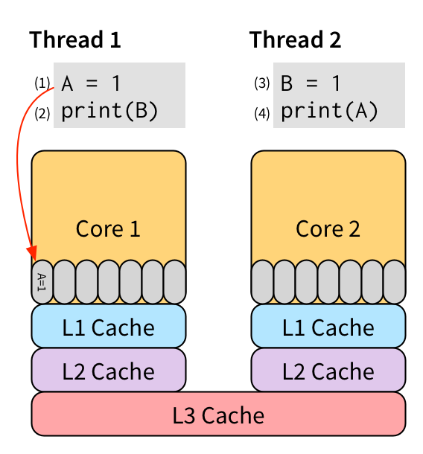
Implementation: Hardware store buffers
Relaxing W → R order
Put writes into a store buffer and let them execute later (when necessary)
Unrelated reads (no data dependencies) from the same processor can continue!
Ref: https://www.cs.utexas.edu/~bornholt/post/memory-models.html

Slide 10
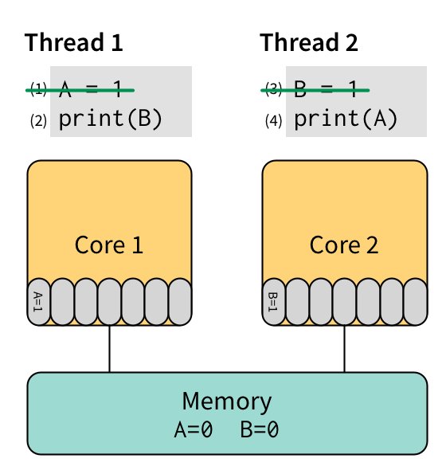
Considerations with W → R relaxation
Now print(A) and print(B) may print 0 even though they are “after” the write instructions
However, this might make your program much faster!
Ref: https://www.cs.utexas.edu/~bornholt/post/memory-models.html

Slide 11
Understanding Relaxation
E.g., if W(rite) → R(ead) relaxation
Find W before Rs (can be multiple Rs)
Must be simple W/R, not control instructions like while(...) etc
Check if there are data dependencies
R → W || W → W || W → R
If no dependencies, the W can go after any of the Rs
X = 5
print Y
print Z
Can
become
print Y
print Y
print Z
X = 5
X = 5
print Z

Slide 12
Understanding Relaxation: Not-Possible Case
E.g., if W → R relaxation
Find W before Rs (can be multiple Rs)
Must be simple W/R, not control instructions like while(...) etc
Check if there are data dependencies
R → W || W → W || W → R
If no dependencies, the W can go after any of the Rs
X = 5
print X
print Z

Slide 13
Understanding Relaxation: Not-Possible Case
E.g., if W → R relaxation
Find W before Rs (can be multiple Rs)
Must be simple W/R, not control instructions like while(...) etc
Check if there are data dependencies
R → W || W → W || W → R
If no dependencies, the W can go after any of the Rs
X = 5
while(Y == 0);
print Z

Slide 14
Memory Models in CS3210
Property | Sequential Consistency (SC) | Relaxed Consistency: Total Store Ordering (TSO) | Relaxed Consistency: Processor Consistency (PC) | Relaxed Consistency: Partial Store Ordering (PSO)
Respects data dependencies within the same core (e.g., don’t touch: x = 5, read x) | Yes
Preserves R → R and R → W order | Yes
Preserves W → R | Yes | No | No | No
Preserves W → W | Yes | Yes | Yes | No
All processors must be able to see same value before a read completes? (Write Atomicity) | Yes | Yes | No | Yes

Slide 15
Agenda
Tutorial: Memory Consistency
Tutorial: CUDA thought process

Slide 16
Question 1: Sequential Consistency

Slide 17
Question 1a: Sequential Consistency
P1
P2
P3
X = 1
while(Y==0);
Z = 2
Y = 1
while(Z==0);
X = 3
while(T==0);
T = X
while(T==0);
print A
A = X
print B
B = X
Initial question: given sequential consistency, what values are guaranteed to be the same at the end of all instructions?

Slide 18
Question 1a: Sequential Consistency
P1
P2
P3
X = 1
while(Y==0);
Z = 2
Y = 1
while(Z==0);
X = 3
while(T==0);
T = X
while(T==0);
print A
A = X
print B
B = X
We can draw the write->read dependencies (thicker lines = while)

Slide 19
Question 1a: Sequential Consistency
P1
P2
P3
X = 1
while(Y==0);
Z = 2
Y = 1
while(Z==0);
X = 3
while(T==0);
T = X
while(T==0);
print A
A = X
print B
B = X
What values are guaranteed to be the same at the end?
Y = 1 must be true - no other writes to Y
Z = 2 must be true, no other writes to Z
The unknowns are: A, B, T, X

Slide 20
Question 1a: Sequential Consistency
P1
P2
P3
X = 1
while(Y==0);
Z = 2
Y = 1
while(Z==0);
X = 3
while(T==0);
T = X
while(T==0);
print A
A = X
print B
B = X
What values can A, B, T, X have after all operations have completed?
What matters: when does X = 3 happen wrt (T, A, B = X)?
How many unique output combinations are there?

Slide 21
Question 1a: Sequential Consistency
P1
P2
P3
X = 1
X = 3
X = 1 already done
T = X
A = X
B = X
What values can A, B, T, X have after all operations have completed?
The only relevant interleaving is (T,A,B = X) and (X = 3)
5 possible positions for X = 3 (note: X=3 can run before X=1)
X = 1 ⇒ {T, A, B} = 1 || {X, T, A, B} = 3 || X = 3, T = 1, {A, B} = 3 || X = 3, {T, A} = 1, B = 3 || X = 3, {T, A, B} = 1

Slide 22
Question 1b: Sequential Consistency
P1
P2
P3
X = 1
while(Y==0);
Z = 2
Y = 1
while(Z==0);
X = 3
while(T==0);
T = X
while(T==0);
print A
A = X
print B
B = X
How can we print A, B, as different values?
X = 1 … ⇒ A = X ⇒ print A ⇒ X = 3 ⇒ B = X ⇒ print B

Slide 23
Question 1c: Sequential Consistency
P1
P2
P3
X = 1
while(Y==0);
Z = 2
Y = 1
while(Z==0);
X = 3
while(T==0);
T = X
while(T==0);
print A
A = X
print B
B = X
How can we change this to print the same value for A, B?

Slide 24
Question 1c: Sequential Consistency
P1
P2
P3
X = 1
while(Y==0);
X = 3
Y = 1
while(Z==0);
Z = 2
while(T==0);
T = X
while(T==0);
print A
A = X
print B
B = X
How can we change this to print the same value for A, B? [np]
Swap Z = 2, X = 3 (X = 3 must happen before T, A, B sets to X)

Slide 25
Question 1c: Sequential Consistency
P1
P2
P3
X = 1
while(Y==0);
X = 3
Y = 1
while(Z==0);
Z = 2
while(T==0);
A = X
while(T==0);
print A
B = X
print B
T = X
How can we change this to print the same value for A, B? [np]
Swap Z = 2, X = 3 (X = 3 must happen before T, A, B setting)
Put T = X after setting A, B (set A, B first then release the prints)
Will print (A,B = 1) or (A,B = 3) ⇒ can you see why?

Slide 26
Question 1d: Fails under TSO/PC/PSO?
P1
P2
P3
X = 1
while(Y==0);
X = 3
Y = 1
while(Z==0);
Z = 2
while(T==0);
A = X
while(T==0);
print A
B = X
print B
T = X
Will we still print the same A, B under TSO/PC/PSO?

Slide 27
Question 1d: Fails under TSO/PC/PSO?
P1
P2
P3
X = 1
while(Y==0);
X = 3
Y = 1
while(Z==0);
Z = 2
while(T==0);
A = X
while(T==0);
print A
B = X
print B
T = X
Will we still print the same A, B under TSO/PC/PSO?
TSO: Relax W → R on same processor if no data dependencies
Still OK: there are no W -> R instructions to reorder here!
Control/cmp instructions don’t count here

Slide 28
Question 1d: Fails under TSO/PC/PSO?
P1
P2
P3
X = 1
while(Y==0);
X = 3
Y = 1
while(Z==0);
Z = 2
while(T==0);
A = X
while(T==0);
print A
B = X
print B
T = X
Will we still print the same A, B under TSO/PC/PSO?
PC: Relax W → R on same processor, processors see writes at diff times
Still OK: there are no W -> R instructions to reorder here!
Control/cmp instructions don’t count here

Slide 29
Question 1d: Fails under TSO/PC/PSO?
P1
P2
P3
X = 1
while(Y==0);
X = 3
Y = 1
while(Z==0);
Z = 2
while(T==0);
A = X
while(T==0);
print A
B = X
print B
T = X
Will we still print the same A, B under TSO/PC/PSO?
PSO: Relax W → R, W->W on same processor if no dependencies
Fails! PSO can reorder this code back to our original code
Remember: we only swapped write orders (e.g., X=3, Z=2)

Slide 30
Question 2: Relaxed Consistency

Slide 31
Q2: Relaxed Consistency
P1
P2
P3
X = 5
while(X==0);
while(Y==0);
Y = 2
Y = 6
Z = 5
print Y
print Z
print X
We observed prints of X = 5, Y = 2, Z = 0
Under which relaxed consistency models is this valid? [p]

Slide 32
Q2: Relaxed Consistency
P1
P2
P3
X = 5
while(X==0);
while(Y==0);
Y = 2
Y = 6
Z = 5
print Y
print Z
print X
We observed prints of X = 5, Y = 2, Z = 0
Under which relaxed consistency models is this valid? [p]
Tactic: try from most strict model first: sequential consistency
Totally possible: P1 runs entirely, then P2, then P3
Therefore if possible under SC, possible under all others!

Slide 33
Q2: Relaxed Consistency
P1
P2
P3
X = 5
while(X==0);
while(Y==0);
Y = 2
Y = 6
Z = 5
print Y
print Z
print X
We observed prints of X = 0, Y = 2, Z = 5
Under which relaxed consistency models is this valid? [p]

Slide 34
Q2: Relaxed Consistency
P1
P2
P3
X = 5
while(X==0);
while(Y==0);
Y = 2
Y = 6
Z = 5
print Y
print Z
print X
We observed prints of X = 0, Y = 2, Z = 5
Under which relaxed consistency models is this valid? [p]
Idea: try to find invariants that must be broken.
print X = 0 ⇒ while(Y == 0) triggered ⇒ Y != 0
Contradiction! Y != 0 ⇒ X != 0 if SC
So this cannot be sequential consistency or TSO
Not TSO: this is not explained by W → R swapping

Slide 35
Q2: Relaxed Consistency
P1
P2
P3
X = 5
while(X==0);
while(Y==0);
Y = 2
Y = 6
Z = 5
print Y
print Z
print X
We observed prints of X = 0, Y = 2, Z = 5
What about PC?
Can: X = 5 reaches P2 but not P3 yet (no write atomicity)
What about PSO?
Can: W ← → W was swapped (Y = 2 before X = 5)

Slide 36
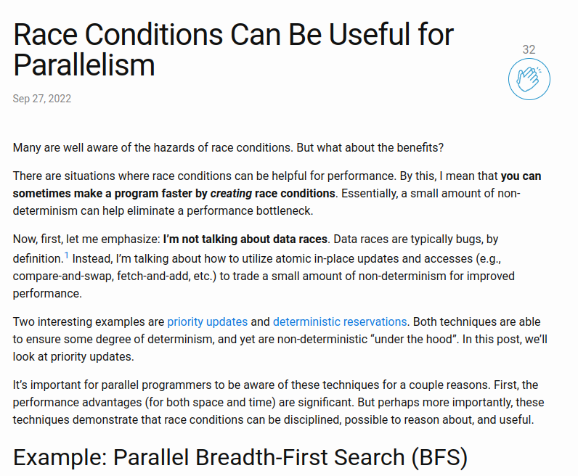
Why does this matter?
Almost everywhere we assume sequential consistency for multithreaded programs.
It’s already hard to think of all possibilities!
Most architectures do not do sequential consistency
if you don’t know about consistency models, low-level code might have issues / code might be slow and you don’t know why
if you do know about consistency models, your code can be super-fast and correct.

Slide 37
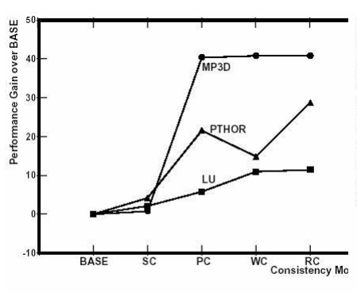
Why does this matter?
ASPLOS 1991 paper showing speedup of:
Sequential consistency
Processor consistency
Weak consistency
Release consistency
over baseline, over 3 different programs.

Slide 38
Question 3: Matrix-Vector Mul on GPU (Finals)

Slide 39
Q3: Matrix-Vector Mul on GPU (Finals)
Is the CUDA memory model shared/distributed/both? [p]

Slide 40
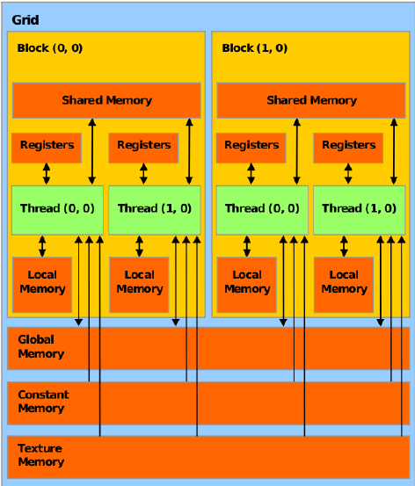
Q3: Matrix-Vector Mul on GPU (Finals)
Is the CUDA memory model shared/distributed/both? [p]
Both: distributed+shared
“shared memory” is private to the block and must be explicitly
copied
Also: host vs device memory

Slide 41
Q3: Matrix-Vector Mul on GPU (Finals)
A kernel uses 64 registers
Each block uses 512 threads
GPU device has 1024x64 registers total, Compute Capability 6.x
GPU has only 1 SM (Streaming Multiprocessor)
How many resident blocks / warps on the SM? [p]

Slide 42
Q3: Matrix-Vector Mul on GPU (Finals)
A kernel uses 64 registers
Each block uses 512 threads
GPU device has 1024x64 registers total, Compute Capability 6.x
GPU has only 1 SM
How many resident blocks / warps on the SM?
# of registers required per block:
(512 threads) x (64 registers for each thread to run)
Total number of resident blocks:
(1024x64) total no. of registers in SM / (512x64) registers per block
2 blocks
2 blocks x (512 / 32 warps per block) = 32 warps

Slide 43
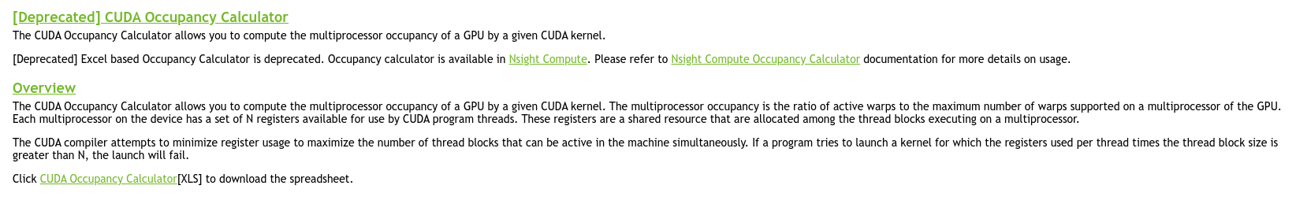
Real World: CUDA Occupancy Calculator
Excel version is deprecated (NVIDIA wants you to use their Nsight Compute program), but still useful to see!
Using an online version for ease: https://xmartlabs.github.io/cuda-calculator/
Compute Capability 6.x
64 registers per thread
512 threads per block
Notes:
https://xmartlabs.github.io/cuda-calculator/

Slide 44
Q3: Matrix-Vector Mul on GPU (Finals)
Implementing matrix-vector multiplication
Really a lot of ways to do this!
Think and discuss on how you would approach this problem
Things to think about:
Block size? What happens if it is too big? Too small?
How much work per thread?
Memory accesses – managed or nah?
Memory storage – global? shared? texture?

Slide 45
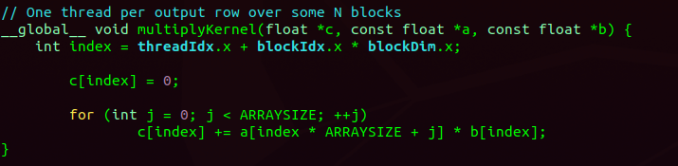
Q3: Matrix-Vector Mul on GPU (Finals)
Most simple version
Each CUDA thread handles 1 row of the output matrix c
All threads read from global memory (matrix a, vector b)
and write back to global memory (vector c)
srun --gpus=nv ./matrix-vector-mul-simple
Any suggestions for improvement?
Notes:
srun -G titanrtx /usr/local/cuda/bin/nvcc -o matrix-vector-mul-simple --std=c++17 -arch sm_70 ./matrix-vector-mul.cu

Slide 46
Q3: Matrix-Vector Mul on GPU (Finals)
Most simple version
Each CUDA thread handles 1 row of the output matrix c
All threads read from global memory (matrix a, vector b)
and write back to global memory (vector c)
Any suggestions for improvement?
Answer is always: understand problem size, profile first, then see: srun --gpus=nv nvprof ./matrix-vector-mul-simple

Slide 47
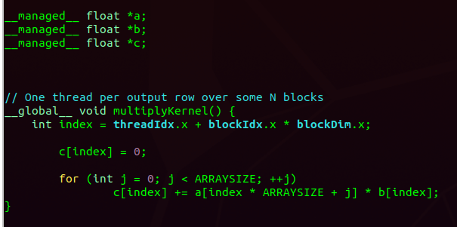
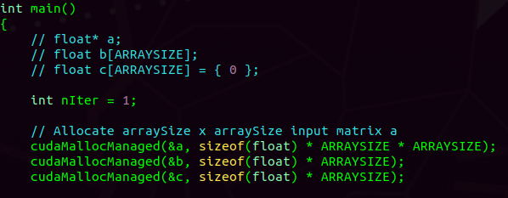
Q3: Matrix-Vector Mul on GPU (Finals)
Could try to cudaMallocManaged and let CUDA figure out how/when to copy the matrices?
Sometimes letting CUDA bring the pages of memory into the GPU on-demand can be better (overlap computation and memory)
As usual – profile!!
Notes:
srun -G titanrtx /usr/local/cuda/bin/nvcc -o matrix-vector-mul-managed --std=c++17 -arch sm_70 ./matrix-vector-mul-managed.cu

Slide 48
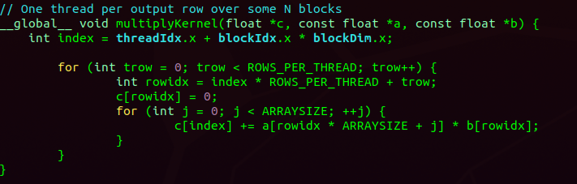
Q3: Matrix-Vector Mul on GPU (Finals)
What if one thread handles multiple rows? (e.g., 32 per thread)
Bad idea… spending a lot of time multiplying
Notes:
srun -G titanrtx /usr/local/cuda/bin/nvcc -o matrix-vector-mul-multirow --std=c++17 -arch sm_70 ./matrix-vector-mul-multirow.cu

Slide 49
What if the data is too large to fit into shared memory?
Any ideas?
We can split the multiplication into multiple iterations (multiple calls to the kernel)
Each call to the kernel copies a subset of the data to shared memory
Note: this is really what happens in AI stuff on the GPU - many datasets cannot fit into GPU memory!

Slide 50

End of tutorial 3
Slides uploaded!
If your attendance has not been marked, lmk
Feedback: bit.ly/feedback-theodore or scan below
Email: theo@comp.nus.edu.sg

